Slide 1
Asset Management – Resources and Funding
Yukon Community of Practice
March 29, 2019
Community Services | Community Affairs

Slide 2
Overview - Asset Management in Canada
Federation of Canadian Municipalities (FCM)
Canadian Network of Asset Managers (CNAM)
NAMS Canada
Communities of Practice around Canada
Yukon AM Community of Practice
NWT Community of Practice
Asset Management BC (AMBC)
Atlantic Infrastructure Management Network (AIM Network)
And more….

Slide 3
FCM – Federation of Canadian Municipalities “We are the national voice for Canada’s local governments”
Resources
Guides
Presentations – i.e. a ready-to-use presentation for council
Videos
Funding – MAMP, Municipal Asset Management Program
https://fcm.ca/en

Slide 4
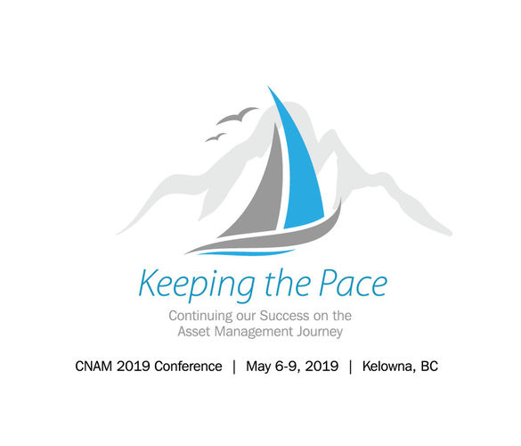
CNAM - Canadian Network of Asset Managers
The Canadian Network of Asset Managers is the association of public infrastructure asset management in Canada.
Yearly Asset Management Conference
May 6-9, 2019 in Kelowna, BC
Newsletter
Webinars
“Asset Management 101”
https://cnam.ca/

Slide 5
NAMS Canada
NAMS Canada Mission
To be the peak Canadian professional association that leads public works and services, infrastructure planning, delivery, and operations.
NAMS Training
http://www.namscanada.org/home

Slide 6
Communities of Practice in Canada
Asset Management BC (AMBC)
https://www.assetmanagementbc.ca/
Asset Management in Alberta
https://www.alberta.ca/municipal-asset-management.aspx
Atlantic Infrastructure Management Network
https://www.aimnetwork.ca/

Slide 7
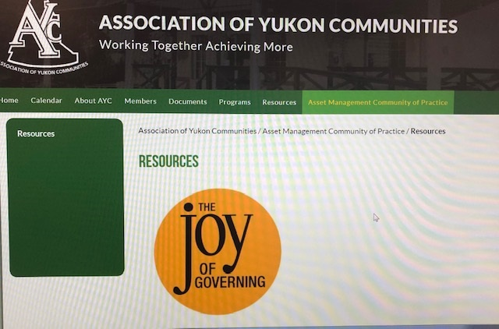
Yukon – Asset Management Community of Practice
http://www.ayc-yk.ca/asset_management_community_of_practice/resources

Slide 8
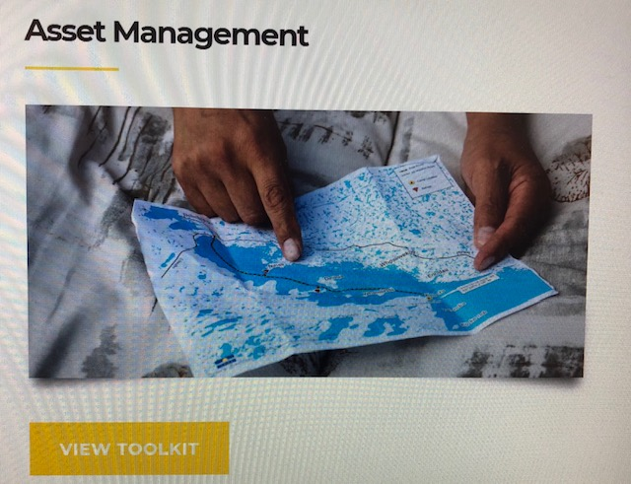
NWTAC - NWT Association of Communities
Asset Management Toolkit
AM Plan Template and Guide
AM Policy Template and Guide
Daily Inspection Forms (and videos!)
Lifecycle Costing
Buildings, Arenas, Pools
Fleet and Equipment
Levels of Service Guides
Lots more!!!!
https://assetmanagement.toolkitnwtac.com/

Slide 9
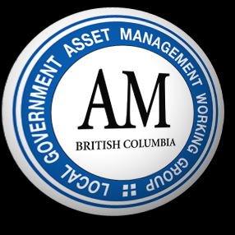
AMBC – Asset Management BC
Asset SMART – A Local Government Self-Assessment Tool
A Guide to Developing A Municipal AM Policy
Examples (i.e. Town of Gibson’s AM Policy)
Presentations (i.e. City of Prince George Presentation on Developing Levels of Service)
https://www.assetmanagementbc.ca/

Slide 10
How/where do I start … and continue?
Sign up for newsletters (example from AMBC)
Go to a CNAM conference
Watch a CNAM webinar
FCM presentation
Visit other Communities of Practice websites
Read, read, read
Contact us!!

Slide 11
The Future of Asset Management
Building asset management culture in your organization
Infrastructure Funding and Gas Tax Funding
Turn-over in your organizations
Linking asset management, environmental sustainability and climate change

Slide 12
Questions? Comments?
Kirsti de Vries
Community Advisor
Community Affairs, YG

